Slide 1
影像處理、電腦視覺及深度學習概論 (Introduction to Image Processing, Computer Vision and Deep Learning) Homework 2
TA:
West: player210421@gmail.com
Office Hour: 17:00~19:00, Mon.
10:00~12:00, Wed.
At CSIE 9F Robotics Lab.

Slide 2
Notice (1/2)
Copying homework is strictly prohibited!! Penalty: Grade will be zero for both persons!!
If the code can’t run, you can come to our Lab within one week and show that your programming can work. Otherwise you will get zero!!
Due date => Midnight 23:59:59 on 2020/12/31 (Thur.)
No delay. If you submit homework after deadline, you will get 0.
Upload to => 140.116.154.1 -> Upload/Homework/OpenCv_Hw2
User ID: opencvdl2020 Password: opencvdl2020
Format
Filename: Hw2_StudentID_Name_Version.rar
Ex: Hw2_F71234567_林小明_v1.rar
If you want to update your file, you should update your version to be v2, ex: Hw2_F71234567_林小明_v2.rar
Content: project folder*( including the pictures ) *note: remove your “Debug” folder to reduce file size

Slide 3
Notice (2/2)
Python (recommended)
Python 3.7 (https://www.python.org/downloads/)
opencv-contrib-python (3.4.2.17)
Matplotlib 3.1.1
UI framework: pyqt5 (5.15.1)
C++ (check MFC guide in ftp)
OpenCV 3.3.1 (https://opencv.org/release.html)
Visual Studio 2015 (download from http://www.cc.ncku.edu.tw/download/)
UI framework: MFC

Slide 4
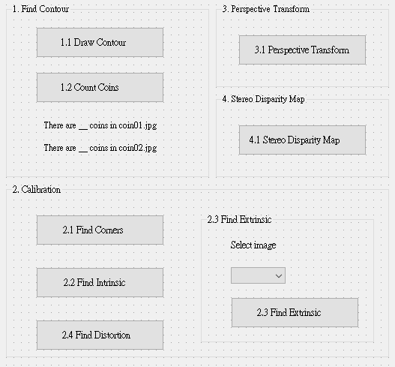
Assignment scoring (Total: 100%)
1. (20%) Find Contour (出題：Shan)
1.1 (10%) Draw Contour
1.2 (10%) Count Coins
2. (20%) Camera Calibration (出題：Max)
2.1 (5%) Corner detection
2.2 (5%) Find the intrinsic matrix
2.3 (5%) Find the extrinsic matrix
2.4 (5%) Find the distortion matrix
3. (20%) Augmented Reality (出題：Oran)
4. (20%) Stereo Disparity Map (出題：Oran)
4.1 (10%) Compute disparity map
4.2 (10%) Calculate the depth
5. (20%) Dogs and Cats classification Using ResNet50 (出題：Bill)
UI Example
Augmented Reality
3.1 Augmented Reality

Slide 5
1. (20%) Find Contour (出題：Shan)
1.1 (10%) Draw Contour
1.2 (10%) Count Coins

Slide 6
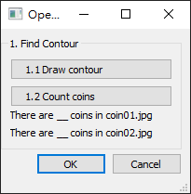
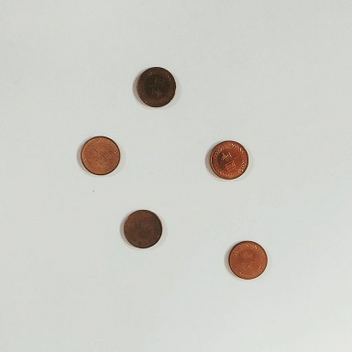
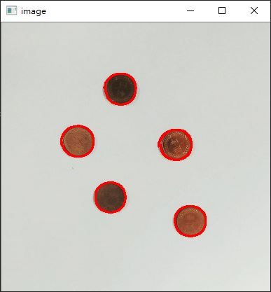
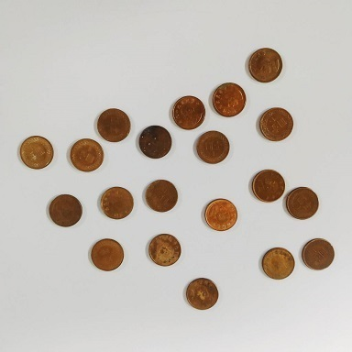
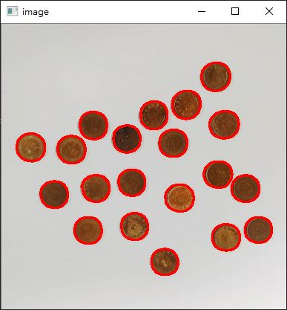
1.1 Find Contour – Draw Contour
Given: two color images, “coin01.jpg” and “coin02.jpg”
Q: 1)
Hint: Textbook Chapter 8, p.234 ~ p.241
RGB ➔ Grayscale ➔ Binary
Remember to use Gaussian Blur to remove the noise.
Using some edge detection functions to get better results. (Ex: cv2.Canny)
(出題：Shan)
Draw Contour: Using OpenCV functions to find the contours of coins in two images.
Coin01.jpg
Draw Contours
Coin02.jpg
Draw Contours

Slide 7
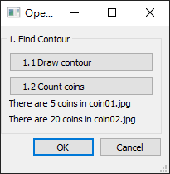
1.2 Find Contour – Count Coins
(出題：Shan)
Given: two color images, “coin01.jpg” and “coin02.jpg”
Q: 2)
Hint: Textbook Chapter 8, p.234 ~ p.241
Calculate how many contours returned by cv2.findContours
Count Coins: Using OpenCV functions to find how many coins in two images.
5 coins
20 coins
Original UI
Show num.

Slide 8
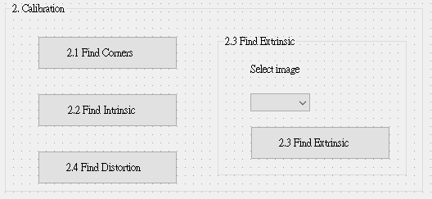
2. (20%) Camera Calibration (出題：Max)
2.1 (5%) Corner detection
2.2 (5%) Find the intrinsic matrix
2.3 (5%) Find the extrinsic matrix
2.4 (5%) Find the distortion matrix

Slide 9
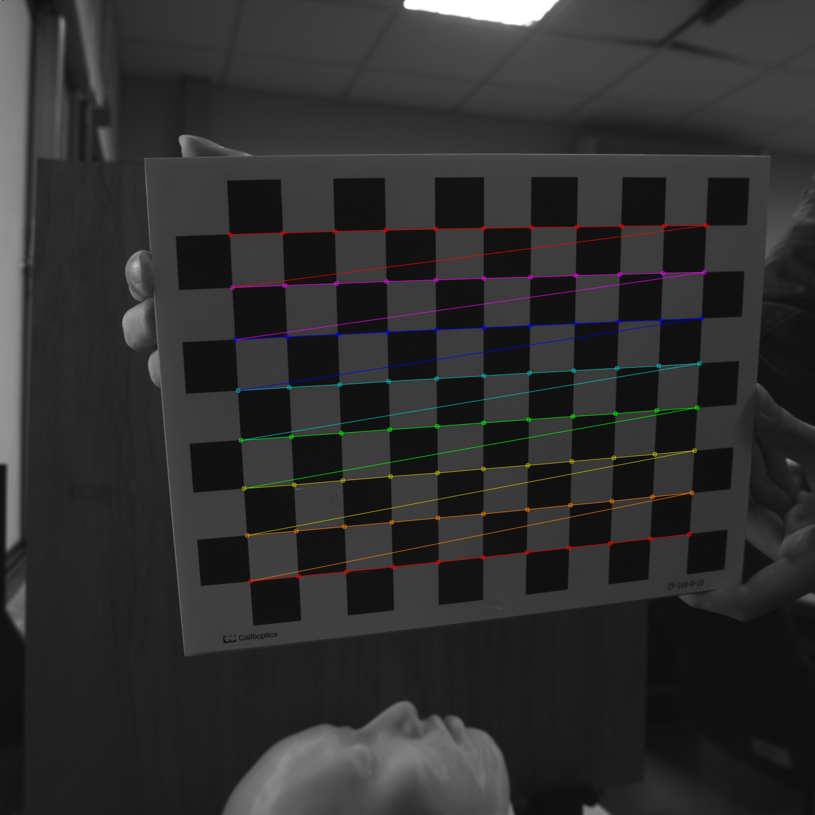
2.1 (5%) Corner Detection
Given: 15 images, 1.bmp ~ 15.bmp
Q: 1) Find and draw the corners on the chessboard for each image.
2) Click button “1.1” to show the result.
Hint :
OpenCV Textbook Chapter 11 (p. 398 ~ p. 399)
cvShowImage(…);
Ex:
9

Slide 10
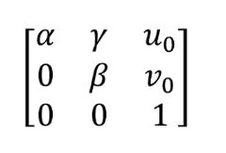
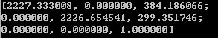
2.2 (5%) Find the Intrinsic Matrix
Given: 15 images, 1.bmp ~ 15.bmp
Q: 1) Find the intrinsic matrix ():
2) Click button “1.2” and then show the result on the console window.
Output format:
Hint: OpenCV Textbook Chapter 11 (P.398 ~ p.400)
(Just an example)

Slide 11
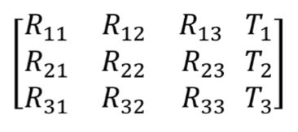
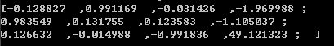
2.3 (5%) Find the Extrinsic Matrix
Given: intrinsic parameters, distortion coefficients, and the list of 15 images
Q: 1) Find the extrinsic matrix of the chessboard for each of the 15 images, respectively:
2) Click button “1.3” and then show the result on the console window.
Output format:
Hint: OpenCV Textbook Chapter 11, p.370~402
(Just an example)
(1) List of numbers: 1~15
(2) Select 1, then 1.bmp will be applied, and so on

Slide 12
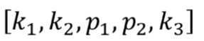
2.4 (5%) Find the Distortion Matrix
Given: 15 images
Q: 1) Find the distortion matrix:
2) Click button “1.4” to show the result on the console window.
Output format:
Hint:
Distortion coefficients can be obtained simultaneously with intrinsic parameters
OpenCV Textbook Chapter 11 (P.398 ~ p.400)
(Just
an example)

Slide 13
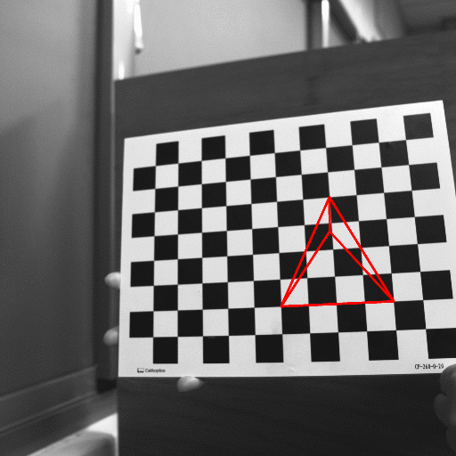
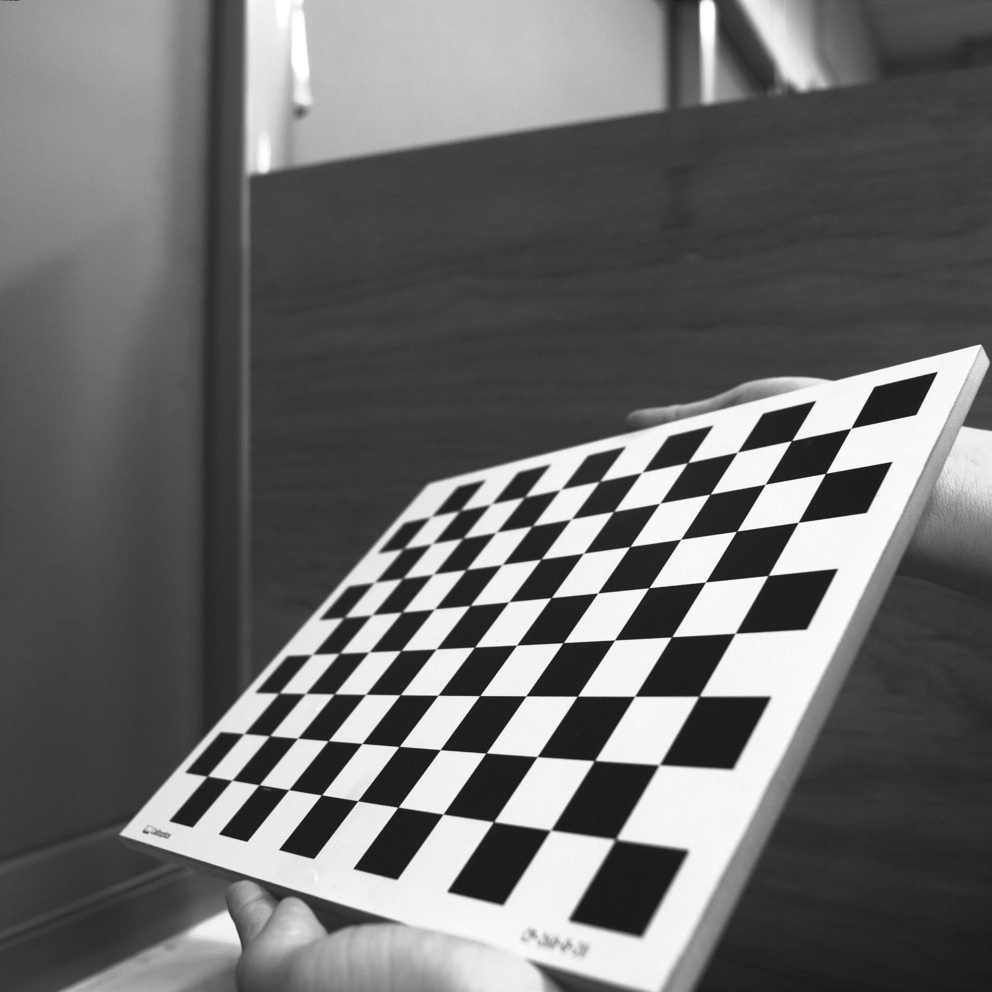
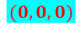



3. (20%) Augmented Reality (出題：Oran)
Given: 5 images: 1~5.bmp
Q:
1) Calibrate 5 images to get intrinsic, distortion and extrinsic parameters
2) Draw a “pyramid” on the chessboards images(1.bmp to 5.bmp)
3) Click the button to show the tetrahedron(四面體) on the picture. Show each picture 0.5 seconds (total 5 images)
Hint : Textbook Chapter 11, p.387~395 Calibration
p.405~412 Projection
cv::calibrateCamera()
cv::projectPoints()
Demo:
3D Object coordinates:
Vertex (3, 3, -3)
Corners(1, 1, 0)(3, 5, 0)(5, 1, 0)
(3,3,0)
$$y$$
(3, 5, 0)
$$x$$
(3, 3, -3)
$$z$$
(5, 1, 0)
(1, 1, 0)
$$(0,0,0)$$

Slide 14
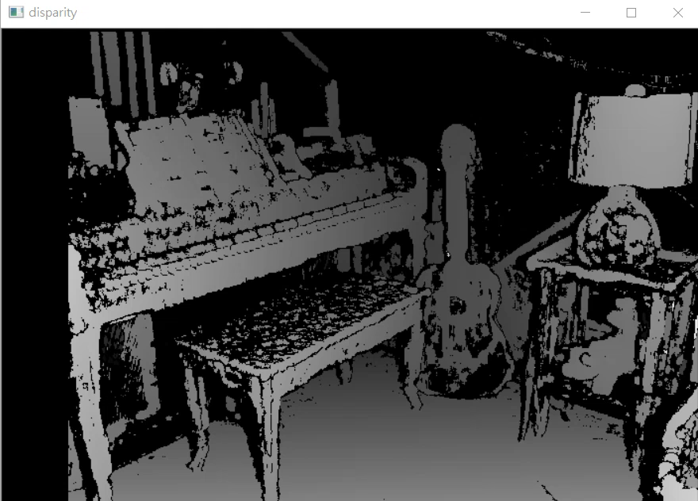
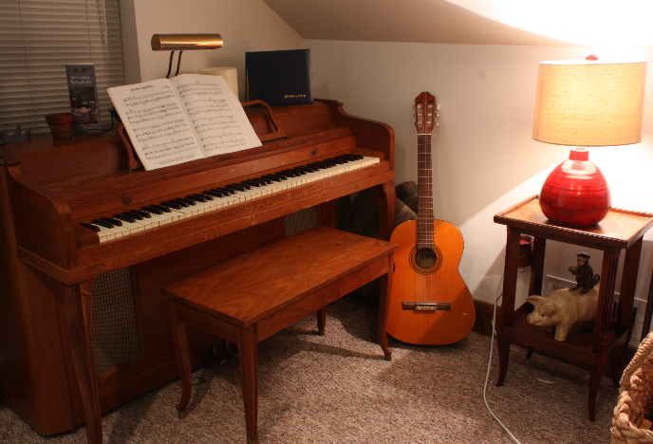
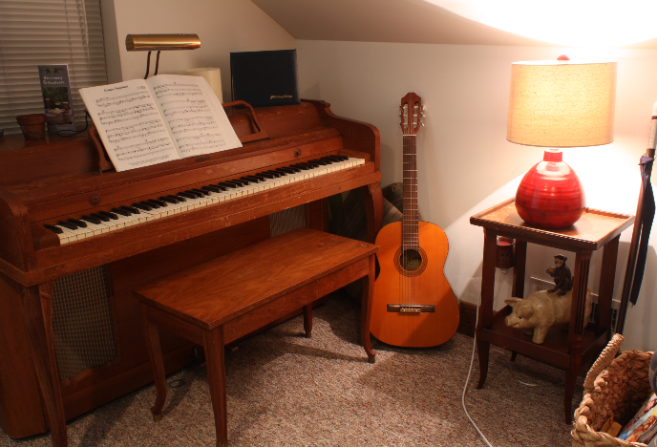
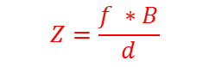
4. (20%) Stereo Disparity Map (出題：Oran)
Given: a pair of images, imL.png and imR.png (have been rectified)
Q:
1) (10%) Click button “4.1 Stereo Disparity Map” and compute the disparity map/image based on Left and Right stereo images
2) (10%) Select a point on disparity map from 4.1, calculate the depth and show both the disparity value and the depth on the image. (Note: user can repeat 2) (EX: Result Video)
Hint: Textbook Chapter 12 (P.451): StereoBM::create(numDisparities, blockSize) or StereoSGBM::create()
1) Block Size: Must be odd and within the range [5, 255]
2) Search range and direction: Disparity range: Must be positive and divisible by 16. Map disparity range to gray value range 0~255 for the purpose of visualization.
(2826*178)/(123+disparity(pixel))=depth 2095
16進制轉8進制通道3
Camera information: Baseline=178 mm, focal length=2826 pixels, $c_{x}^{right}−c_{x}^{left}$=123 pixels
OpenCV Textbook Chapter 11 (P.372-373) & OpenCV Textbook Chapter 12 (P.436)
$$Z=\frac{f ∗B}{d}$$
imgL.png
imgR.png
Result Video
Left Image (Reference Image)
Right Image

Slide 15
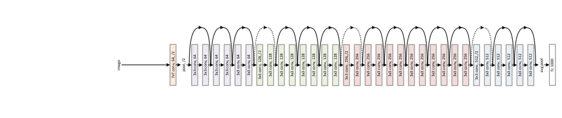
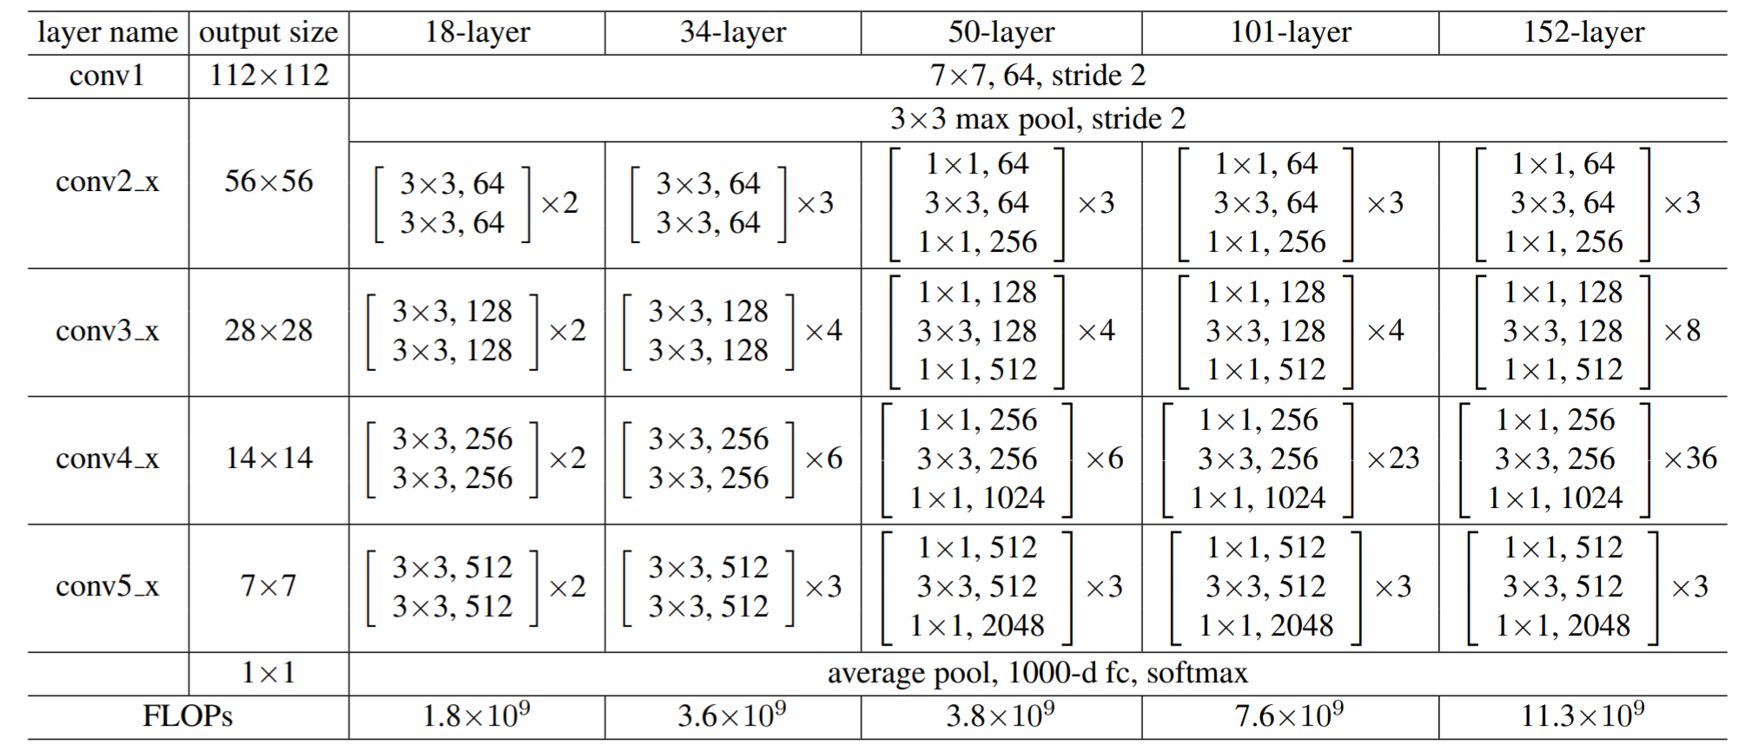
5.0 (20%)Dogs and Cats classification Using ResNet50 (出題：Bill)
from model.ResNet import ResNet model = ResNet(50)
from tensorflow.keras.applications.resnet50 import ResNet50 model = ResNet50(weights=None)
1) Dataset introduction:
ASIRRA (Animal Species Image Recognition for Restricting Access) is a HIP(Human Interactive Proof) that works by asking users to identify photographs of cats and dogs, that's supposed to be easy for people to solve, but difficult for computers. Now we can use artificial intelligence technology to achieve this goal.
(2) The dataset includes 12501 photos of cats and 12501 photos of dogs. You need to download them in Reference below(R2), and split the training set, validation set and test set by yourself.
2) Objective:
You need to use python to write the ResNet network
and complete the questions on the next few pages.
3) Environment Requirement
(1) Python 3.6
(2) Tensorflow 1.14
(3) Opencv-contrib-python 4.1.1 (for image show and write)
Fig. ResNet’s Network Architecture
R. Reference
R1) Deep Residual Learning for Image Recognition
R2) https://www.microsoft.com/en-us/download/details.aspx?id=54765 (ASIRRA)
Fig. ResNet50's Schematic Diagram

Slide 16
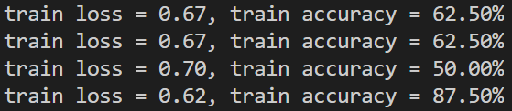
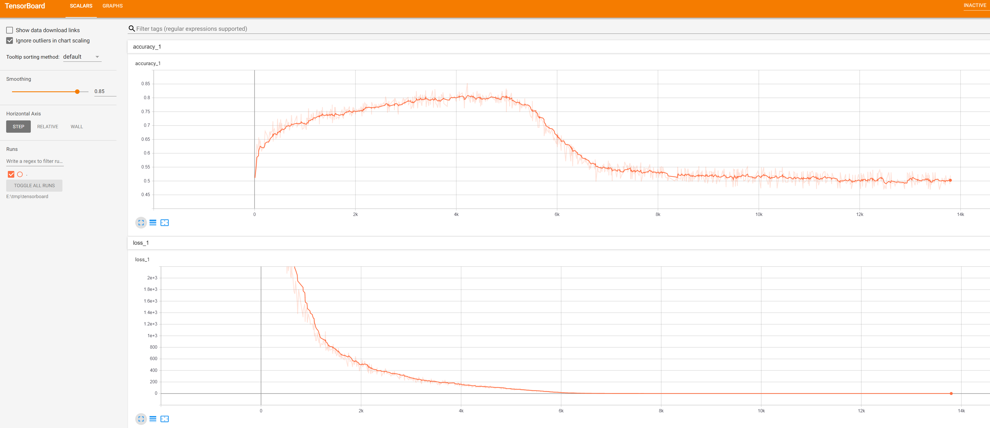
5.1 Training by your computer at least 5 epochs and show(or upload) your source code of ResNet50. (5%)
Fig. Accuracy display during training
5.2 Training at home and use TensorBoard to monitor, Save the final screenshot of TensorBoard (5%, Use other tools can get 3%).
Fig. Example of training with TensorBoard

Slide 17
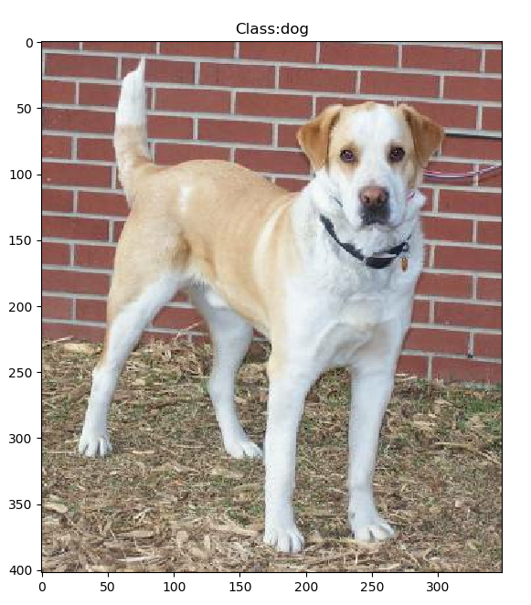
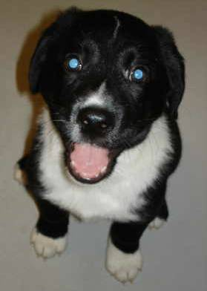
5.3 Randomly select a picture from the test set and mark its category.(5%)
Fig. Classification display example
5.4 Try to resize the pictures in the dataset to expand the amount of training data, write the code(3%) and draw the comparison table of accuracy, save it as a picture.(2%)
Fig. Example of resize operation
Fig. Resize augmentation comparison example

